Slide 1

J.Lodge Data Science & Analytics
Gianna Maniaci
2020 Summer Intern Program
Notes:
Hello My name is Gianna Maniaci and I am the 2020 summer intern for J.Lodge Data Science and Analytics.

Slide 2
About Me
Rising Senior at The College of William & Mary
Major: Data Science
Minor: Public Health
From Manassas, Virginia
Fun Fact: I have visited 9 National Parks in the U.S.
Notes:
Here is a little about me: I am a rising Senior at the College of William & Mary with only one semester remaining (Exciting!), I am majoring in Data Science and minoring in Public health, I am from Manassas VA and one fun fact about me is that I have been to 9 US national parks and one item on my bucket list is to visit all 62 of them.

Slide 3
Agenda
Goal
Discovering Unseen Patterns
Challenge 1
Representing Text as Data
Challenge 2
Length of Calls
Challenge 3
Preprocessing Transcripts
Challenge 4
Quality of CallMiner Transcripts
Data Pipeline
Results
Notes:
Here is my presentation overview, I am excited to share with you a little about my project, some challenges I overcame and my final results.

Slide 4

GOAL: Discovering Unseen Patterns
Residential Data – 300,000 Calls and 600+ columns Business Data – 300,000 Calls and 300+ columns
Customer Segmentation - the process of separating customers into groups to help market to each group effectively
Can we cluster the customers into groups that will help this large telecom company understand how to better market to each one?
Notes:
At the beginning of my internship, My manager Jake and I worked together to find a meaningful project in which I would be able to learn new skills but yet still make a beneficial contribution to the J.Lodge team. I was given 2 sets of data, Residential and Business. Each had about 300,000 calls. As I began discussing with Jake the goals of the summer, I spent some time researching Customer Segmentation. This is the process of separating customers into groups to help market to each group effectively. Jake and I decided to take a more in depth look at the transcripts and try to discover if there were patterns among the calls or the customers that would help this company market to the customers in the future.

Slide 5

CHALLENGE 1: Representing Text as Vectors
Natural Language Processing :
the science of extracting meaning and learning from text data
4 Methods of Data Manipulation
Bag of Words
TF-IDF
LDA
Doc2Vec
Notes:
This project began with a lot of research into Natural Language Processing. This is the science of extracting meaning and learning from text data. This was very exciting as I had not yet had a chance to work in this field of Data Science before and I can honestly say I have learned SO much over the course of my 10 weeks here. This leads to my first challenge, which is how to represent the text data as vectors. As you know, computers can not speak English, so it is important to reformat this textual information into numbers. There were four methods which could be used to complete this vectorization process; Bag of Words (BoW), Term Frequency – Inverse Document Frequency (TF-IDF), Latent Dirichlet Allocation (LDA), and Doc2Vec.

Slide 6
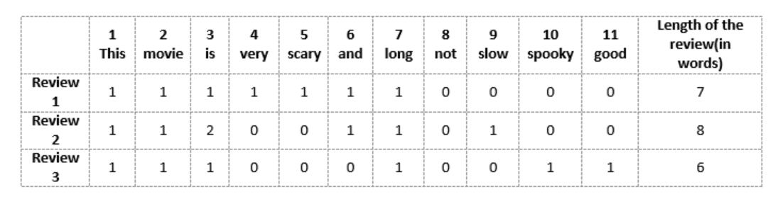
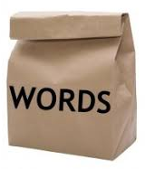
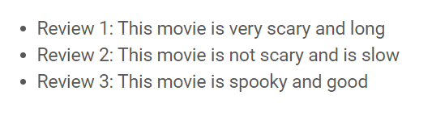
Bag of Words (BoW)
Notes:
The first method for manipulating the transcripts into vectors is the Bag of Words model. The Bag of Words model finds each distinct word among all of the transcripts and makes a new column in the Data Frame for that word. If the word is used in that call, it will be marked with a count of how many times the term is present, whereas if it is not present, it will be marked as a 0. These are just a few example sentences to show how it works. Let’s look at the first one, “This movie is very scary and long”, you can see when you look at the data frame that there are 1s in all of the columns with the words used in this review and all the remaining words are marked as zero. None of these sentences were in my data, however, It is easy to see that these data frames have the potential to grow very quickly when using this method, even just when looking at one single phone call, let alone 300,000 phone conversations. The sheer amount of data in this model alone led to a few problems that I will mention in a bit!

Slide 7
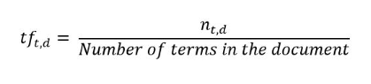
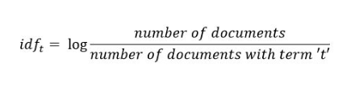
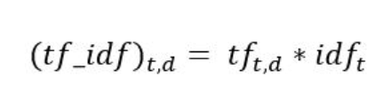
Term Frequency – Inverse Document Frequency (TF-IDF)
Here, in the numerator, n is the number of times “t” appears in the document “d”. Thus, each document and term would have its own TF value.
Notes:
The second method to transform the transcripts into a vector is using the TF-IDF model, which stands for Term Frequency – Inverse Document Frequency. The term frequency piece calculates how often a word is used in one call or document, as you can see, the formula is the number of times a specific term appeared in one document over the total number of terms in the entire document. The Inverse Document Frequency part calculates how “important” the term is in the document. Now when I say important, this is basically a representation of how many documents the specific word appeared in. Let’s look at the word “the” for example. The word “the” is likely to be in most of the calls. When you go to calculate the idf piece of the formula, it will put the number of documents over the number of documents with the word “the”. Since a large number will be going in the denominator of this formula, a smaller number will be outputted. Therefore “the” is not as important as other terms. Then to get the final score, you will multiply the TF value by the IDF value and get the final TF-IDF score. This is then stored in a data frame similar to the way the Bag of Words is stored but instead of the number of times the word appeared and 0s, it stores the TF-TDF score of the word and if the word is not present in the call it simply changes it to NaN, which I have replaced with 0s.

Slide 8
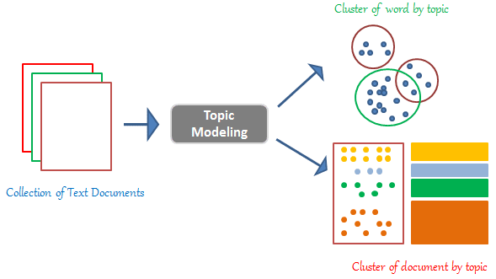
Latent Dirichlet Allocation (LDA)
Topic Modeling Technique
Decides each document’s percent affiliation with each topic.
Notes:
The next method is Latent Dirichlet Allocation. This topic modeling technique goes through each document and word in the document to try to form groups and categorize the document based on the words. The user inputs how many categories they would like the data to be grouped into and the computer gives each document a percentage based off how well the document would fit into each category. The percentages across the data frame for all the categories will add up to 100 for one call. I simply used the default number of topics, which is 100, but if I had more time, I would have loved to build a preparatory model to help distinguish the best number of topics to use.

Slide 9
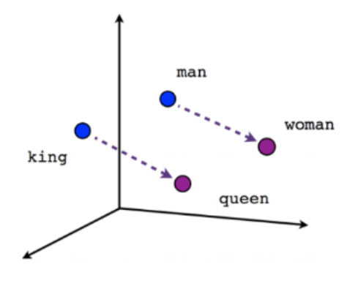
Doc2Vec
Plots documents in multidimensional space, placing documents conveying similar meaning near each other.
Notes:
The final method of manipulating the transcripts into vector form is using Doc2Vec, now this method is a little harder to explain, but I will first explain it with words instead of documents (which is actually something called Word2Vec, but you do not need to know that right now) First, let’s look at this graph. This shows dots for “man”, “woman”, “king”, and “queen”. Word2Vec will plot each word in space near words that convey a similar meaning. So, in this case, “king” would be next to “queen” since they convey a similar meaning and “man” would be next to “woman” since those two words are more similar to each other. Doc2Vec works basically the same way, but it does this with entire documents rather than specific words. The final information returned from this model is the coordinate location of the document in space. This is easy to picture in 2 or 3 dimensions, but it begins to become much harder to understand when for example, it reaches 100 dimensions. I just used the default number of dimensions, 100, but in the future, if I had more time, I would love to find the optimal number of dimensions for this project.

Slide 10
CHALLENGE 2: LENGTH OF CALLS
Effect on Bag of Words
Computation Time
Memory Error
Notes:
The third challenge I came across in my project, was the mere size of the data. The length of each call caused me a great deal of trouble, simply because as the calls got longer, it took much longer to perform computations, as well as used significantly more memory. The longer the calls got, the less information we could expect to get from the Bag of Words model as it is harder to distinguish the impact of having one word in the call vs another when the sheer magnitude of words is just way too large. The computation time also became a big problem. I installed a process called subsetting which would extract the first 100 and last 100 words from the call and basically create a new transcript with just this piece that would ignore the data in the middle. This definitely diminished the length of the call but may have dropped some important information along the way. Memory issues also impacted my work significantly. I did try to combat this by creating a transcript class that would load the calls in one piece at a time rather using the pandas implementation and loading all of the data into memory at once. This did help a little bit, however, as the project got into my final stages, it became more of an issue.

Slide 11
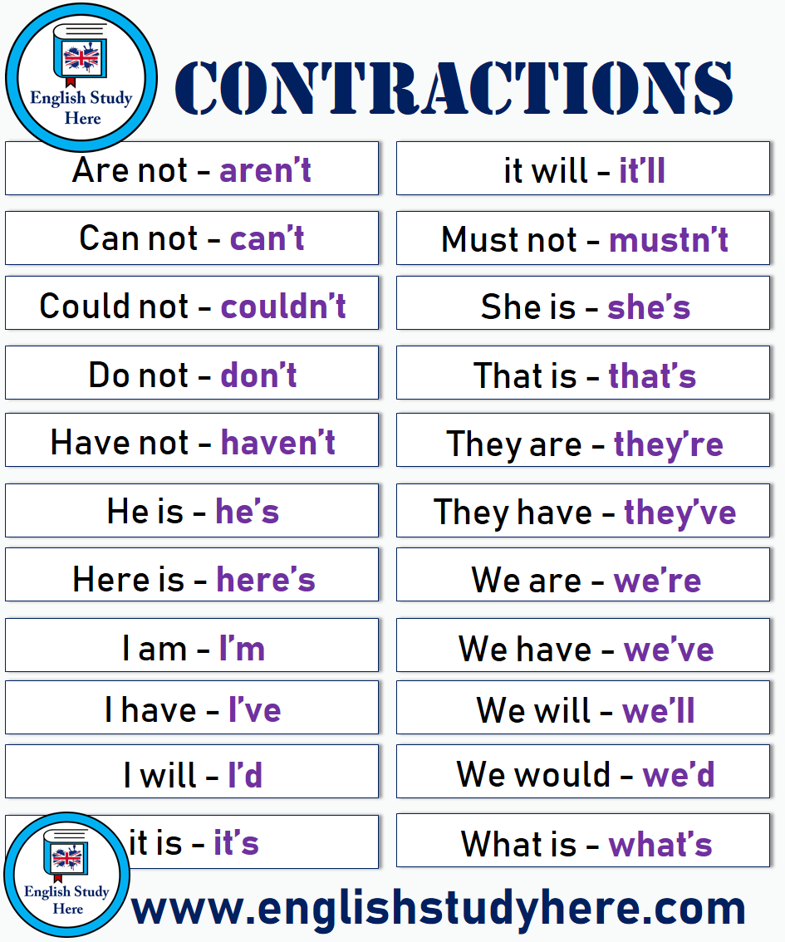
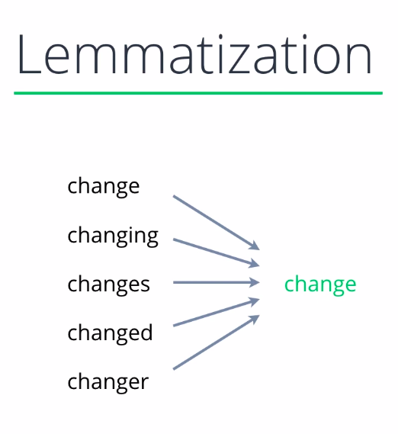
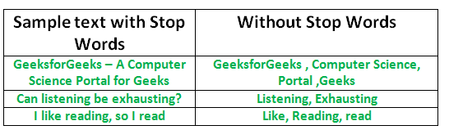
CHALLENGE 3: Preprocessing Transcripts
Notes:
The third challenge was preprocessing the data. Preprocessing is an important part of every natural language processing project, as it allows the data to be put into a more digestible format so the machine learning algorithm can preform better. A few things I did to the data in this stage was expanded contractions, performed lemmatization, and conducted stop word removal. Expanding contractions finds words like “can’t”, “haven’t”, and “would’ve” and changes them to “can not”, “have not”, and “would have”. This initial expansion of contractions, although not too helpful on its own, makes the next preprocessing steps much more efficient. For example, lemmatization reverts all words back to their root. This is helpful for something like Bag of Words where instead of having a column for “change”, “changing”, “changes”, etc., it will only have a column for “change”. The last preprocessing step is stop word removal. This gets rid of commonly used words, such as “the”, “a”, “an”, “in” which would again diminish the size of the Bag of Words Model and reduce computation time.

Slide 12

CHALLENGE 4: Quality of CallMiner Transcript
Only one recording for both the agent and the customer
Poor connection quality
Background noise
Undiscernible accents
Notes:
The last challenge was just the quality of the CallMiner transcripts. This was something I could not really do much about but still had an impact on my final results. CallMiner only has one recording of all the voices on the call, instead of separating it by the customer and the agent. This means that every time the two people talk at the same time, it is very hard to create a clear transcript of the call. Also there are several other factors that may have affected this, such as, the connection quality, background noise, people’s accents, etc.

Slide 13
Data Pipeline
Raw Data
Subset
BoW
TF-IDF
Doc2Vec
No Preprocessing
LDA
Preprocessing
No Subset
Notes:
Now that I have basically walked you through the main concepts and challenges of my project, I would like to show you the data pipeline that I spent a significant amount of time creating. This script starts out with the user feeding in the Raw Data. The user will specify what model they want to use as well as whether or not they want the transcripts to be preprocessed and if they want the data to be subsetted. The data will then get sent in. If the user requested the data to be subsetted, then only the first 100 and last 100 words of the data will be used. If preprocessing was requested, then the transcripts will be lemmatized, the contractions will be expanded, and all stop words will be removed. Next, the data gets sent to be reformatted into a vector format based off whatever model the user specified: BoW, TF-IDF, LDA, and Doc2Vec. Once this process is complete, a data frame will be made with this new vector and get combined with the raw data. This is the final data frame that will then be used for clustering. As you can see, this gives 32 possible combinations of data frames when including the fact that there is both business and residential datasets. The process of conducting preprocessing took about 10 hours for one dataset, so unfortunately I was unable to use the preprocessed data as it just took way too long. I also ended up only looking at the subsetted data to help with the lengthy computation time. This left me with 8 final data frames. If I had more time, I would love to go back and experiment with the other combinations as well.

Slide 14
Tools
python
gensim
spaCy
sklearn
Notes:
Throughout my project I used python to create all my scripts, gensim and spaCy for all of my natural language processing needs. Then I used sklearn for the data analysis and final clustering portion of my project.

Slide 15
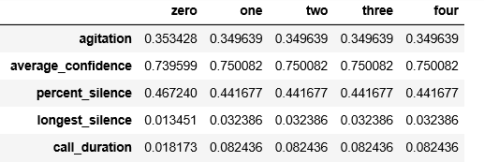
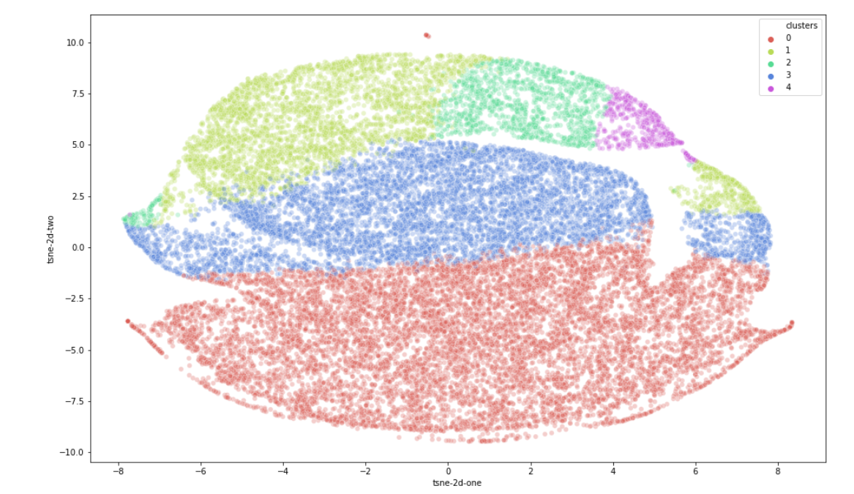
Analysis
KMeans Clustering
Visualization using T-distributed stochastic neighbor embedding (T-SNE)
Min Max Scaling used to rescale the range of features to between [0, 1]
Observed greatest variance among clusters per feature
Notes:
Once I had the 8 final DataFrames from my pipeline, I then used Kmeans clustering to try to find clusters in the data. I set the cluster number to 5, which was just a recommendation from Jake, but again, if I had more time I would have loved to try to find the optimal number of clusters. Above is a visual representation of the clusters created using T-SNE. I then began to analyze the clusters. I used min max scaling to reformat the data to be between a range of 1 and 0. This standardizes the data to allow it to be easier to compare from feature to feature. Then if you look at this chart, I organized the data by cluster, found the mean for each feature and then calculated the variance for each feature between the clusters. I then sorted the variances by greatest to smallest and used this information to decide which features had the greatest impact on each cluster’s final sales.

Slide 16

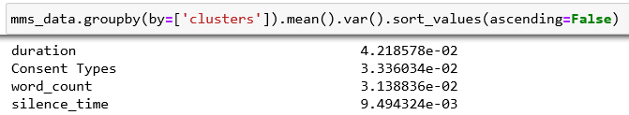
Results
Transcripts did not provide much distinguishable information
Duration
Sales
Word count
Silence Time
Future recommendations:
Use preprocessed Data
Use non-subsetted data
Find optimal clusters, dimensions, and topics
Notes:
Unfortunately, the features that had the greatest variance among the clusters for both the residential and business data were basically different variations of sales, call duration, word count, and silence time. The transcripts did not provide much distinguishable information. Now this is not in any way, shape or form a disappointing find. It just means that I found which direction not to look in and am able to turn my attention to some of the other possible paths that I could take for this project. If I could continue in the future, I would love to take a look at the preprocessed version of the transcripts to maybe see if this would help narrow down the impactful pieces of the transcript. I think it would also be beneficial to take a look at the non-subsetted data as well as to find the optimal clusters, dimensions, and topics and then compare this with my results from this summer. Hopefully, someone will get a chance to look at my data and continue what I did not have time to investigate. I am really grateful for my experience this summer! Thank you to all of my teammates who have been so kind, helpful, and welcoming over the past 10 weeks. It has been a great experience! Thank you for listening!

Slide 17
Bibliography
Abhishek SharmaHe is a data science aficionado. “Exploratory Data Analysis For Text Data: EDA Using Python.” Analytics Vidhya, 28 Apr. 2020, www.analyticsvidhya.com/blog/2020/04/beginnersguideexploratory
dataanalysis-text-data/.
“Gensim: Topic Modelling for Humans.” Radimrehurek: Machine Learning Consulting, radimrehurek.com/gensim/auto_examples/core/run_core_concepts.html#sphx-glr-auto-examples-core-run- core-concepts-py.
Kelechava, Marc. “Using LDA Topic Models as a Classification Model Input.” Medium, Towards Data Science, 13 Apr. 2020, towardsdatascience.com/unsupervised-nlp-topic-models-as-a-supervised-learning-input-cf8ee9e5cf28.
Naskar, Anindya. “Latent Dirichlet Allocation for Beginners: A High Level Overview.” Think Infi, 14 Feb. 2019, www.thinkinfi.com/2019/02/lda-theory.html.
Purva HuilgolTrainee Data Scientist at Analytics Vidhya. Pursuing Masters in Data Science from the University of Mumbai.“BoW Model and TF-IDF For Creating Feature From Text.” Analytics Vidhya, 25 June 2020, www.analyticsvidhya.com/blog/2020/02/quick-introduction-bag-of-words-bow.
Shivam BansalShivam “Beginners Guide to Topic Modeling in Python and Feature Selection.” Analytics Vidhya,
20 Jan. 2020, www.analyticsvidhya.com/blog/2016/08/beginners-guide-to-topic-modeling-in-python/.
Shperber, Gidi. “A Gentle Introduction to Doc2Vec.” Medium, Wisio, 5 Nov. 2019, medium.com/wisio/a-gentle- introduction-to-doc2vec-db3e8c0cce5e.
Notes:
These are some of the sources that helped me along the way!

